Slide 1
Fundamental Big Data Analysis & Science
Clean code and unit testing

Slide 2
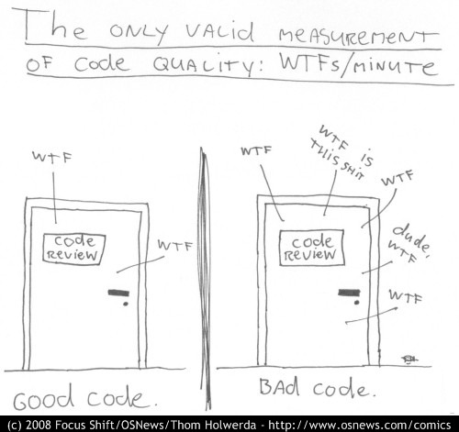
Why is clean code important?

Slide 3
Why would you write clean code?
Fact: code is more often read than written
Fact: people will like you more if you write clean code
Fact: future you will really like you if you write clean code
Fact: thinking about problems becomes easier when you write clean code

Slide 4
Important conventions in any language
Self documenting code
Split it up into functions
Don’t write comments unless they are necessary
Make simple and small pieces of code with a single responsibility
Do not return null from a function
Don’t comment out code; remove it

Slide 5
Why write unit tests?
Makes you think about your code
Makes code cleaner
Promotes use of functions, functions are easier to test ;)
Makes sure your code does what you expect it to do

